Slide 1
Theatre Management System
Prepared By : -
Sumit Nainani Parthiv Aneesh
Yash Gurjar Gajendra Jangir
Komal Gourav
Ankur Kaushik Anshul Kumar
Aditya Berwal

Slide 2
Index
Product Perspective
Major Functions
User Characteristics
SRS Document
UML Diagrams And Out put Screenshots

Slide 3
Product Perspective
The TMS is designed to replace the manually driven Theatre
management system and introduce automation and efficiency.
The TMS will enable the SM to Add shows in Theatre and their details, Fix the prices of the ordinary and balcony
seat for booking and assign seats to functionaries, VIPs as complementary gift.
The Customer/Spectator can book their ticket from authorized SP and get their tickets printed with details. The SP can login in to TMS and all their transactions are recorded.
The spectators and SM can query details regarding show timing, booking and
payment status respectively.

Slide 4
Major Functions
The Theatre Management Software (TMS) consists
of the following major functions:
1. Release and maintaining the information of various shows
conducted in the Theatre.
2. Price fixing and Allocating Balcony and Ordinary seats for sale
or offer as complementary gifts to functionaries or VIPs.
3. Booking of tickets by spectators from authorized sale
manager.
4. Printing of tickets with show details and ticket number.

Slide 5
Major Functions
5. Cancellation of Tickets and Refund.
6. Querying the different class of available seats by spectator/Customer.
7. Create Log-in accounts for authorized sale persons.
8. Recording all the transaction of sales person using person ID.
9. Querying the percentage of seats booked, amount collected
on each class for any show, amount collected by each sales
person by show manager.

Slide 6
User Characteristics
SHOW MANAGER
The Theatre has a SM with responsibility of management of every show conducted in the Theatre, fix the prices of each class of ticket and assign tickets to functionaries and VIPs. He also monitors the SP.
SALES PERSON
SPs are responsible for booking and cancellation of tickets on the request of spectator.
SPECTATOR/CUSTOMER
Spectator query information about show details and seat availability. He books tickets through authorized sales persons and can cancel it with adequate refund.

Slide 7
SRS

Slide 8
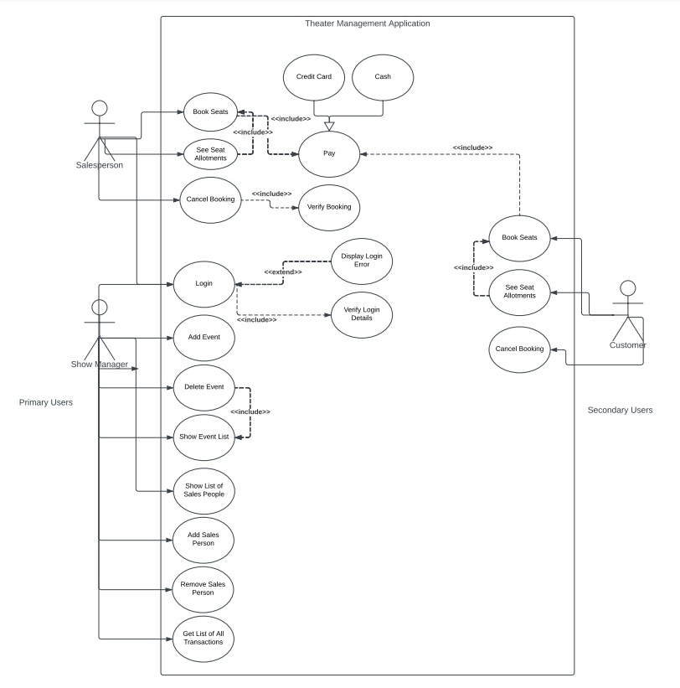
UML DIAGRAM :
USE CASE DIAGRAM

Slide 9
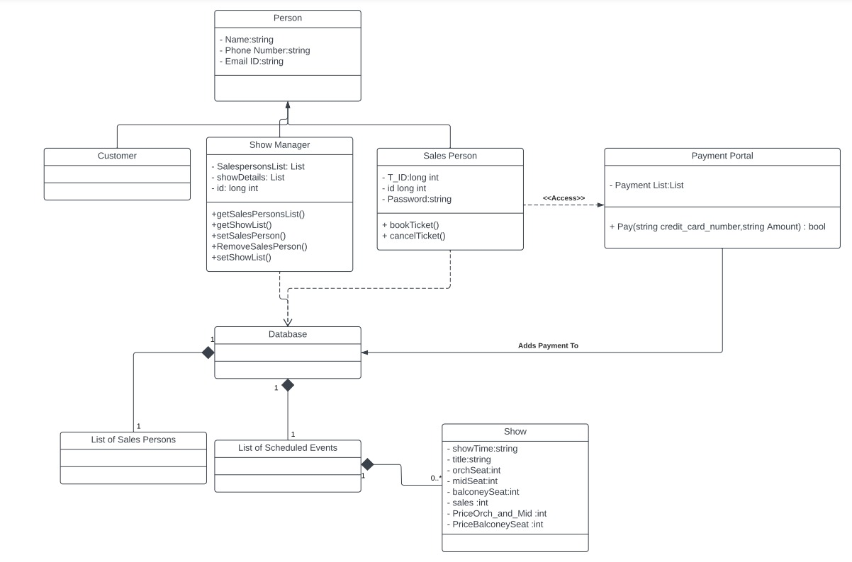
UML Diagram :
Class Diagram

Slide 10
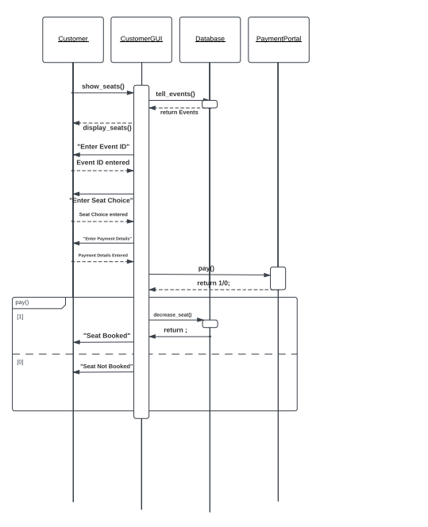
Sequence Diagram
Book A Room

Slide 11
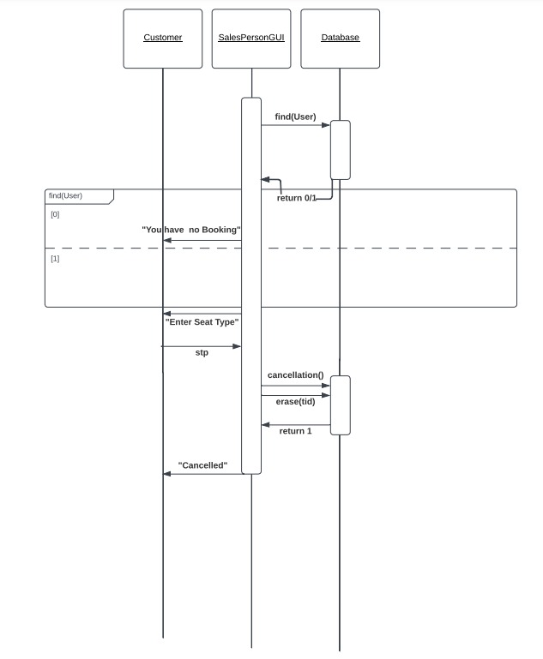
Sequence Diagram
Cancel Booking

Slide 12
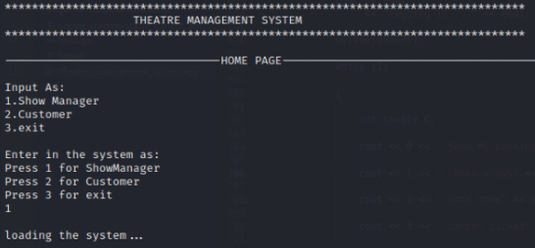
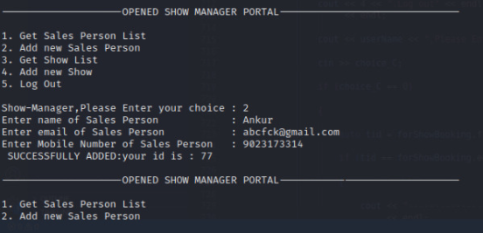
GUI Screenshots
TMS HOME SCREEN :
The Home page will provide switching options to Interfaces like: Show Manager(SM) Interface & Spectator/Customer Interface.
Now here in upper image we have that options of switching to Interfaces and in below image we have opted for SM Interface.

Slide 13
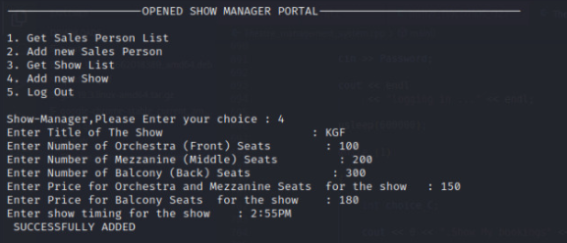
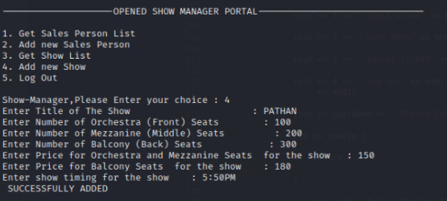
GUI Screenshots
TMS Show Manger(SM) Portal working :-
Here,moving with same SM Interface portal,our SM is adding shows to our Theatre in the upper image &
In below image another show is added to the theatre.

Slide 14
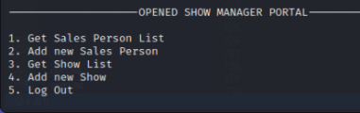
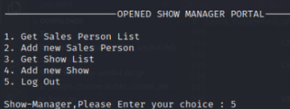
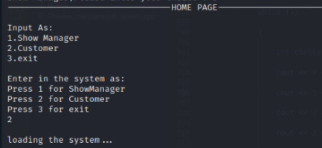
GUI Screenshots
TMS Show Manger(SM) Portal working Continued.. :-
In the upper 2 images, SM is picking to Log Out from our Portal &
In below image Home Page portal is opened again.

Slide 15
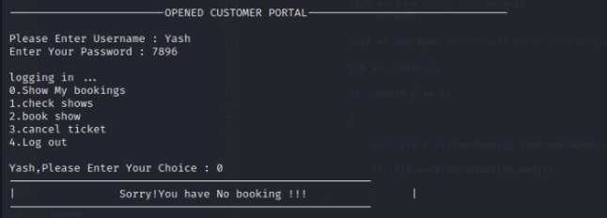
GUI Screenshots
TMS Customer/Spectator Portal Using :-
Here Customer/Spectator Interface is opened and Customer is picking his/her choices.

Slide 16
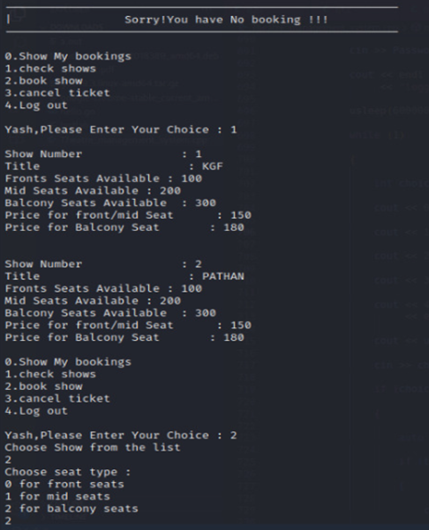
GUI Screenshots
TMS Customer/Spectator Portal working Continued.. :-
Same Customer is booking his/her shows and filling required things in the portal.

Slide 17
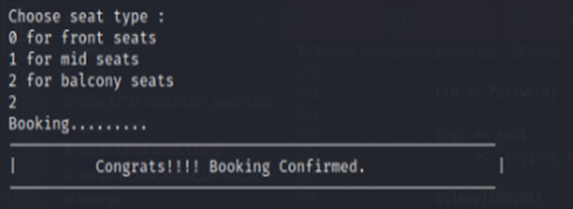
GUI Screenshots
TMS Customer/Spectator Portal working Continued.. :-
Seat type is decided by Customer in Customer portal.

Slide 18
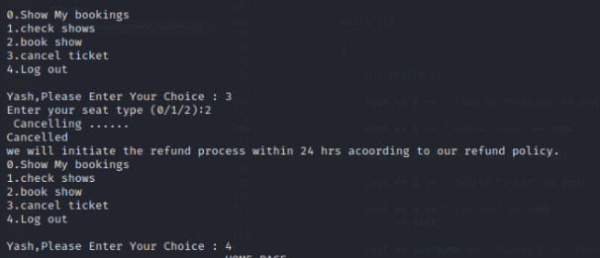
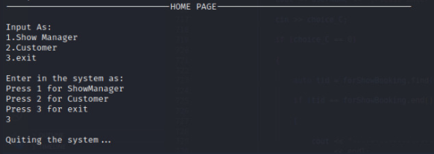
GUI Screenshots
Customer Portal & Home page workings:-
In the upper image,Customer is Canceling his/her ticket and latterly logging out from Customer portal.
In the below image,We are quiting from Home Input portal.

Slide 19
Thank you

